Slide 1
eDossier - Faculty Dossier Management System
Office of Academic Affairs
Margie Ferguson, Senior Associate Vice Chancellor for Academic Affairs
Gail F. Williamson, Director of Faculty Enhancement
INDIANA UNIVERSITY–PURDUE UNIVERSITY INDIANAPOLIS
© 2017 Gail Williamson

Slide 2
Contents
eDossier Access
Candidate Sections
Hyperlinking
Supplemental Folder
Administrative Sections
Resources

Slide 3
eDOSSIER Access
Candidates submitting a dossier will have an eDossier file created in year of submission
Contact your Dean’s Office to request access.
Candidates can access system via edossier.iu.edu or One IU
All documents must be searchable PDFs
Each file must be named to clearly reflect its contents
The IUPUI librarian template has been constructed and will be used beginning in the 2017-18 cycle
Academic Affairs is working with School of Medicine to adopt eDossier for 2018-19 cycle

Slide 4
Candidate Sections

Slide 5
Candidate Sections
50 page limit excluding CV, Appendices, Administrative Sections
Candidate’s Statement
Curriculum Vitae
Teaching (For Librarians: Performance)
Research and Creative Activity (For Librarians: Professional Development)
Professional and University Service (For Librarians: Service)
Appendices reside within the teaching, research and service sections
Dossiers for non-tenure eligible faculty should only include sections relevant to the candidate’s appointment and required areas of evaluation.
See Submission Grid

Slide 6
Welcome Screen
Candidate User Instructions

Slide 7
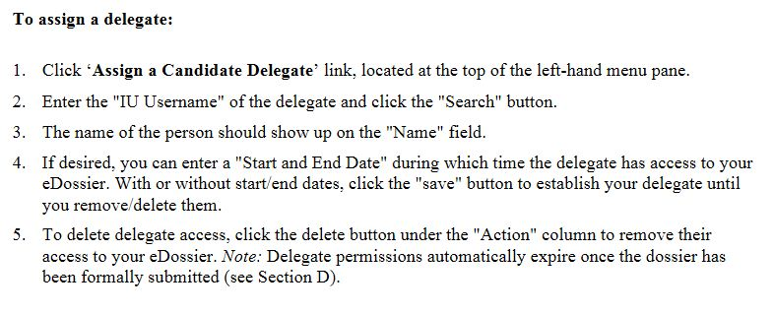
Assign a Delegate or Guest

Slide 8
File Upload

Slide 9
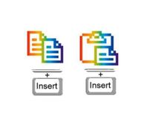
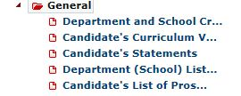
General File Folder
General Folder Contents:
Department and School Criteria: Candidate uploads an official copy of the current department/school criteria for excellence.
Curriculum Vitae: Candidate uploads CV; if core school - upload both IUPUI and IUB required formats clearly labeled
Candidate’s Statement: Candidate uploads statement not to exceed 7 pages (or split 5/2)
Department (School) List of Prospective Referees: Not required for IUPUI dossiers. No need to insert a blank page.
Candidate's List of Prospective Referees: Not required for IUPUI dossiers. No need to insert a blank page.

Slide 10
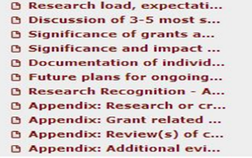
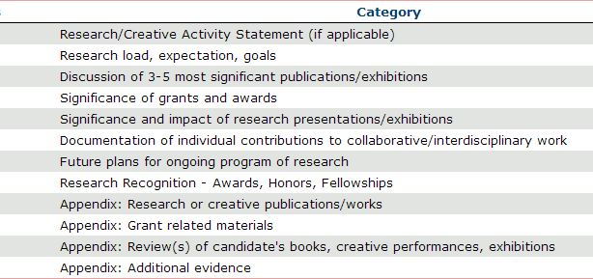
Research/Creative Activity
Research Folder Contents:
Research/Creative Activity: Candidate will upload their evidence in appropriate subfolders.
Faculty for whom research is not required will not have materials to upload in folder.
Subfolders that do not apply to candidate’s case should be left empty.
If candidate cannot find a subfolder with desired title, upload to any section and name file clearly.
Files uploaded in this section count toward the 50-page limit.
Utilize the Research Appendices to provide evidence to support assertions in the research folders.
Files uploaded in the research appendix folders do NOT count toward the 50-page limit.
You can hyperlink to the appendix folders.

Slide 11
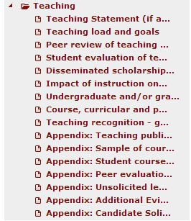
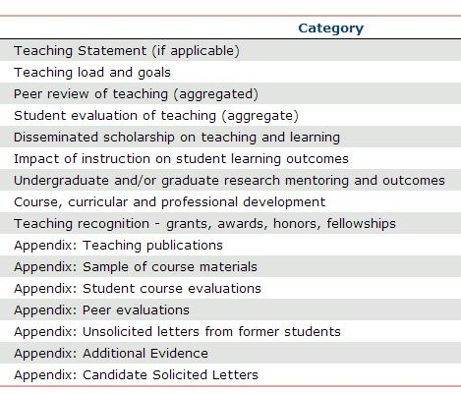
Teaching
Teaching Folder Contents:
Teaching: Candidate will upload their evidence in appropriate subfolders.
Faculty for whom teaching is not required will not have materials to upload in folder.
Subfolders that do not apply to candidate’s case should be left empty.
If candidate cannot find a subfolder with desired title, upload to any section and name file clearly.
Files uploaded in this section count toward the 50-page limit.
Utilize the Teaching Appendices to provide evidence to support assertions in the teaching folders.
Files uploaded in the teaching appendix folders do NOT count toward the 50-page limit.
You can hyperlink to the appendix folders.

Slide 12
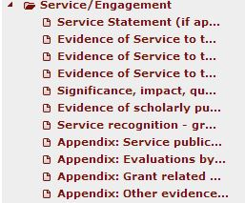
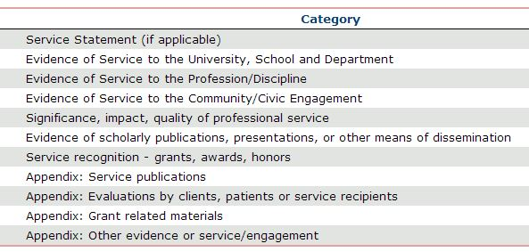
Service
Service Folder Contents:
Service/Engagement: Candidate will upload their evidence in appropriate subfolders.
Faculty for whom service is not required will not have materials to upload in folder.
Subfolders that do not apply to candidate’s case should be left empty.
If candidate cannot find a subfolder with desired title, upload to any section and name file clearly.
Files uploaded in this section count toward the 50-page limit.
Utilize the Service Appendices to provide evidence to support assertions in the service folders.
Files uploaded in the service appendix folders do NOT count toward the 50-page limit.
You can hyperlink to the appendix folders.

Slide 13
CANDIDATE Hyperlinking
Embedding URLs – Linking 2 Documents
Within a file, you may want to point reviewers to another document/file in your dossier. Via the copy URL feature, you can embed the link to the document directly in your statement so reviewers can easily access it.
Select the previously uploaded document you want to link using the Copy Link option in the drop down menu next to the uploaded document.

Slide 14
CANDIDATE Hyperlinking
A dialog box will now appear with the appropriate URL. Copy the URL to your clipboard.
Paste the copied URL into the relevant document before uploading it to your dossier.
Save the document to your computer or server and upload as normal. When a reviewer opens the document from within e-dossier, clicking on the URL link will direct the system (and reader) to the linked file.
Word documents can be uploaded if the PDF does not preserve embedded links
Hyperlinks within eDossier and external to eDossier can be embedded

Slide 15
Submit
Submit Button
In order for the candidate submit button to appear, there must be one file in the first three subfolders in the General section (Department and School Criteria, Candidate's CV and Candidate's Statement).
The submit button is currently disabled for the IUPUI campus.
If the chair is satisfied with the dossier, then they approve the dossier and move it to the first level of review

Slide 16
Supplemental Folder
Supplemental Folder:
Once the Candidate has submitted their dossier, this folder will appear.
Candidate can upload any additional materials at any time (such as a grant funding notification, manuscript accepted for publication) or reconsideration documents in PDF format to the Supplemental Supporting Items subfolder.
The candidate will need to use the submit button to circulate the new information to reviewers.

Slide 17
Administrative Sections

Slide 18
Administrative Sections
Not uploaded nor viewable by candidate
Not part of the candidate’s 50 pages
Review letters and vote records from school-level reviews (levels of review vary among schools:
Dean
Unit/School Committee
Department Chair
Primary/Department Committee
External Assessments
Solicited Reference Letters (solicited by chair; not required)
Assessment of dissemination outlets in the candidate's area of excellence (or in all areas for a balanced case)

Slide 19
Principals – Rights and Access
Deans, department chairs and support staff with administrative rights have access to the External Letters and Solicited Letters folders while the candidate prepares the dossier & during the routing to upload documents.
Reviewers can view all of the candidate folders at any time but cannot make any changes or upload documents to the candidate folders unless the candidate has specifically given delegate access.
Access
Access at the department level – reviewers can only see dossiers for candidates in their department.
Access at the school level – reviewers can see dossiers for all the candidates in their school.

Slide 20
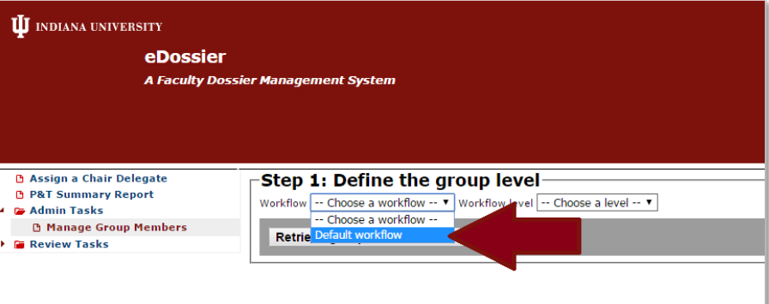
Typical Workflow
The workflow is adjusted for each school’s process if different from the default routing shown here.
Manage Group Member Functionality and Routing Guide
Instructions on how administrative access users set up review routing
Video Tutorial on how administrative access users set up review routing

Slide 21
Principals
Principals can assign a delegate to help them complete tasks. Delegates can only perform certain tasks.
Cannot submit dossier.
Cannot acknowledge supplemental materials nor post internal letters for reconsideration cases.
Principals responsible for routing the dossier to the next level
System requires that the internal evaluative letter must be uploaded and vote recorded.
Once the requirements have been fulfilled, a “route” button appears on the candidate dossier page allowing the principal to route the dossier to the next level of review.
To complete a vote record, click on the Vote Record link below the candidate’s dossier on the left-hand menu pane. Enter the numbers manually by clicking inside of each box of the record. Upload Evaluative letters to the Internal Review folder.

Slide 22
Internal Letters and Vote Records

Slide 23
Assign a Chair Delegate
Click Assign a Chair Delegate link.
Enter IU username of the delegate and click search.
The name will show in the field.
Designate Start/End date if desired.
Click Save.
To delete delegate access, click Delete under the Action column.

Slide 24
Reviewers
The routing/workflow of each candidate’s dossier will be set prior to the candidate submitting their dossier. Once the dossier is ready for review, reviewers are notified via an automated email that the case is ready.
Reviewers are given access permissions according to their eligibility to view particular types of cases. After logging in, reviewers and staff see a list of all e-dossiers they are eligible to view.
After logging in, reviewers will see a "Reviews" tab on the right hand side of the page. Reviewers should click on the tab and then on the "Candidate" name and "Open Dossier" button to open up a candidate’s dossier. To examine a candidate’s materials in the P&T checklist, simply click on the arrows in each section to expand that section further.

Slide 25
Welcome Screen
Instructions for Reviewers and Principals

Slide 26
Access List

Slide 27
Reviewer Details
During the review process, in addition to having view only access to all other folders in the dossier, the Vote Record and Internal Letters folders will be accessible to committee chairs, department chairs and the dean.
Once the review for a level is done, the vote is recorded in the Vote Record and the review letter uploaded to the Internal Letters folder. Then the dossier is routed to the next level for review.
Once routed to the next level access changes to view only.
Each level can view items in these two folders for their level and below.
Committee reviewers will have view access only to all folders in the dossier once it is routed to their committee for review. Each committee can only view dossier contents, the Vote Record and Internal Letters folders for their level and below.

Slide 28
Departmental Level
Pending
Evaluative folders/letters and vote record are now visible

Slide 29
School & Dean Levels

Slide 30
Supplemental Documents
A candidate may add supplemental documents at any time. Documents will be date and time-stamped. When a supplemental document has been submitted, workflow notifications will be sent as a function of “where” the e-dossier is in the review process.
Current level: ‘for your information’ “You are being informed that Candidate X, whose e-dossier is currently under review at your level, has added material(s) to the supplemental folder. [Please notify others at your level (i.e., committee members) of these materials.] No other action is required.
Past level: “Candidate X, for whom you have already voted on, has added material(s) to their supplemental folder. Please consider these materials [and notify others at your level (i.e., committee members) to do so as well].
Choosing ‘Acknowledge’ means that upon review, no further action will be taken.
Choosing ‘Acknowledge with Action’ means that upon review, a formal response (i.e., letter and possible revote) will be uploaded.
‘Acknowledge with Action’ by an earlier level of review: A notification will only be sent to the principal at the current level
“In response to the addition of new materials by Candidate X, a formal response has been offered by an earlier level of review. Please consider these responses [and notify others at your level (i.e., committee members) to do so as well]. No other action is required.”
A delegate cannot acknowledge.

Slide 31
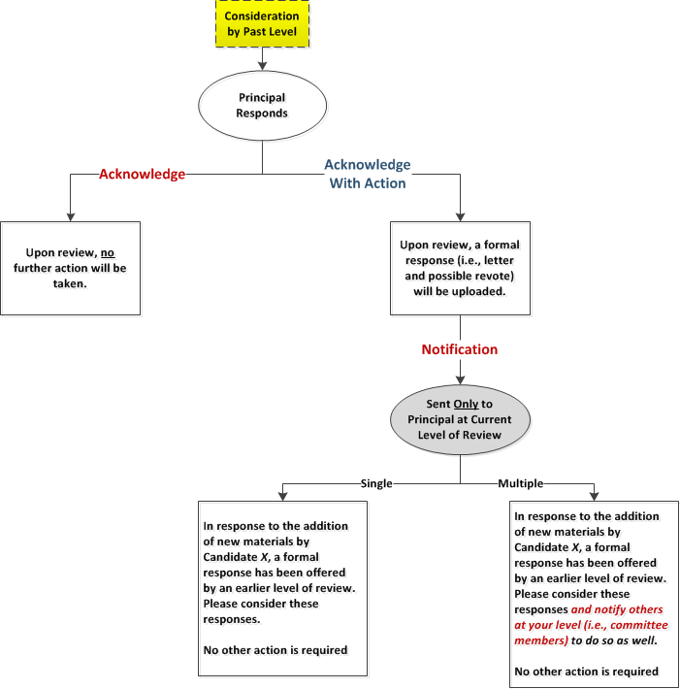
Supplemental Notifications & Actions

Slide 32
Processes Outside eDossier
Conferring on candidate’s documentation prior to submission.
Committee meetings and deliberations for the purposes of review.
Candidate notification of outcomes at each level of review.
Notification of right to reconsideration (for tenure candidates when indicated).
Committee meetings and deliberations in response to reconsideration.

Slide 33
Resources
IUPUI INDIANA UNIVERSITY-PURDUE UNIVERSITY INDIANAPOLIS
eDossier Resources
Submission Grid
Candidate User Instructions
Reviewer and Administrative Access User Instructions
Instructions on how administrative access users set up review routing
Video Tutorial on how administrative access users set up review routing
Frequently Asked Questions (FAQ)
Promotion and Tenure Guidelines
2017-18 Guidelines
2018-19 Guidelines
Sample Dossiers
Other P&T Resources
Charts, Forms, Sample Solicitation Letters
P&T Program Listing and Registration

