Slide 1
e-Dossier Overview
Questions and/or suggestions: edossier@indiana.edu

Slide 2
Project Goals
Replace disparate ‘local’ technical solutions and/or a paper process with an online process that facilitates the ‘building’ of a Dossier by the candidate
Allow for inclusion of elements of scholarship not previously possible (e.g., hyperlinks to blogs and personal web sites)
Provide overall consistency in the dossier structure
Provide administrators and reviewers secure access to dossiers anytime and from anywhere
Improve overall efficiency of the process

Slide 3
Design Objectives
Two primary design drivers:
The system must be easy to use and it must be useful
Deploy embedded workflow technology
Workflow logic reflects the P&T process
Supports automatic notifications when a change in status has occurred
Allows e-dossiers to move independently of each other
Secure 24-7 access
Built using the Kuali Rice framework

Slide 4
Design Components What sets e-dossier apart?
P&T process and routing logic
Repository
Checklist
Evaluations/Votes
Unique features
Push & pull content
Kuali
Workflow
Flexibility
Reporting
Candidates
Reviewers
Administrators
Local Staff
Tools/Templates

Slide 5
e-Dossier Overview

Slide 6
Candidate Side
Log-in through Onestart
During e-dossier preparation, the checklist (main and subfolders) are visible to the candidate
Before submission and through the e-dossier system itself, the candidate may designate delegates who can view and/or assist in uploading materials
After the department chair ‘signs-off’ and the e-dossier formally enters the review process:
The candidate’s e-dossier is frozen
Delegate permissions expire
At this point, candidates may give ‘guest’ access to anyone, but only for viewing of candidate-submitted materials
A “Supplemental” folder is activated and serves as the means through which the candidate can add materials to his/her e-dossier
External letters, internal evaluative letters and vote records are not accessible/viewable to the candidate at any time during the review process
Access to any of these should be managed outside the e-dossier system and according to policy and local practices

Slide 7
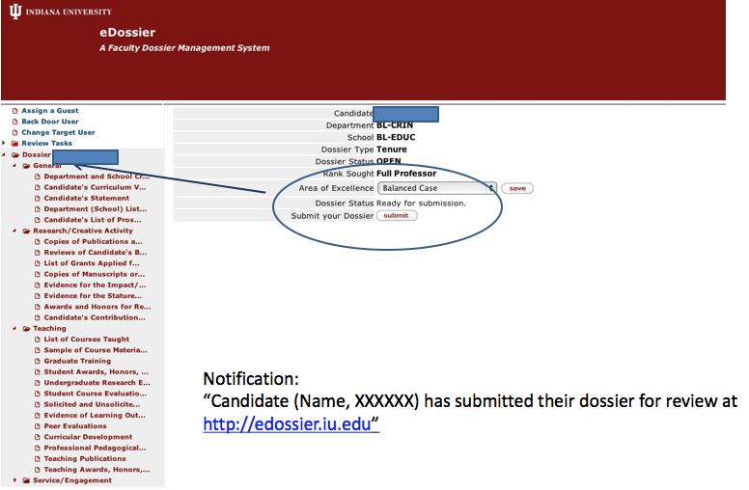
Submit

Slide 8
Reviewer Side
Access is given to eligible reviewers (faculty, administrators) and staff
Reviewers are given access permissions in light of their eligibility to view particular types of cases (e.g., P&T vs. Promotion)
After logging into the system via Onestart, reviewers and staff see a list of all e-dossiers they are eligible to access
Access at a given level
All the materials a candidate has submitted are viewable by reviewers
External letters are viewable to reviewers
Solicited letters (i.e., former students, co-authors, service) are viewable to reviewers
Evaluative letters and vote records are only viewable for one’s own level and lower (i.e., one cannot view higher level evaluative letters or votes)
While reviewers may wish to save and/or print materials the candidate submitted, they should not save, print, or share any external or evaluative letters or votes

Slide 9
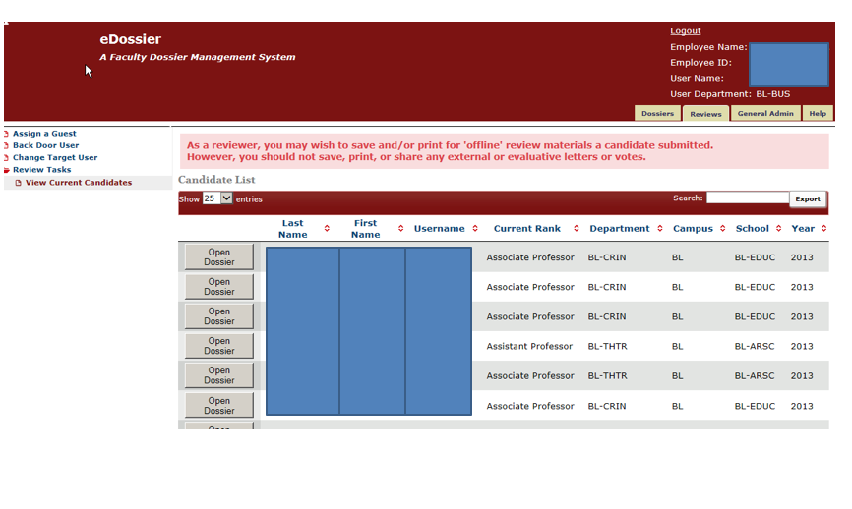
Access List

Slide 10
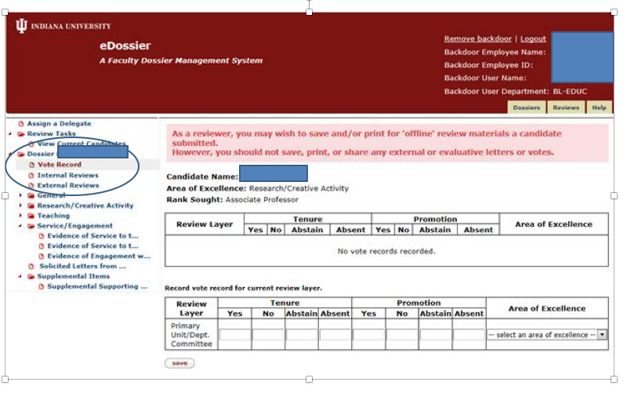
Vote Record

Slide 11
Routing
e-dossiers move (or “route”) individually from one level to the next via Kuali Workflow
Principal routing responsibility rests with certain individuals at each level
Principals: Department Chair, Chair of School Committee, Dean, Chair of Campus Committee, Vice Provost/Chancellor, and Provost/Chancellor
Certain actions (i.e., vote recording, uploading of evaluative letter) must be met before an e-dossier can be routed forward
Through the e-dossier system itself, the principal may designate a delegate who can route and/or assist in routing activities; however, delegates may not ‘acknowledge or acknowledge with action’ the addition of supplemental materials
After routing, reviewers will receive an email notification alerting them that an e-dossier has arrived at their level and is now accessible to them
How a level manages the review process itself is up to local practice and policy (e.g., a committee may meet before any action is taken)

Slide 12
Workflow
Does Your School Follow a Different Workflow?

Slide 13
Supplemental Documents
A candidate may add supplemental documents at any time
Documents will be date and time-stamped
When a supplemental document has been submitted, workflow notifications will be sent as a function of “where” the e-dossier currently is in the review process
Current level: ‘for your information’
“You are being informed that Candidate X, whose e-dossier is currently under review at your level, has added material(s) to the supplemental folder. [Please notify others at your level (i.e., committee members) of these materials.] No other action is required.
Past level:
“Candidate X, for whom you have already voted on, has added material(s) to their supplemental folder. Please consider these materials [and notify others at your level (i.e., committee members) to do so as well].
Choosing ‘Acknowledge’ means that upon review, no further action will be taken.
Choosing ‘Acknowledge with Action’ means that upon review, a formal response (i.e., letter and possible revote) will be uploaded.
‘Acknowledge with Action’ by an earlier level of review:
A notification will only be sent to the principal at the current level
“In response to the addition of new materials by Candidate X, a formal response has been offered by an earlier level of review. Please consider these responses [and notify others at your level (i.e., committee members) to do so as well]. No other action is required.”
A delegate cannot acknowledge

Slide 14
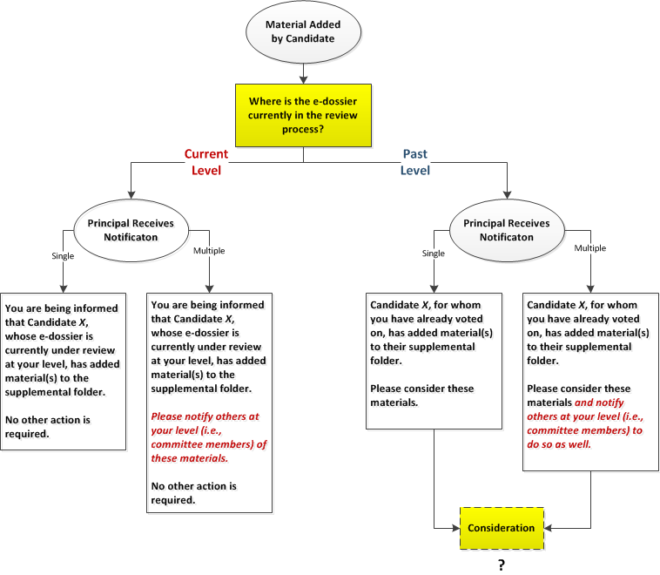
Supplemental Notifications & Actions I

Slide 15
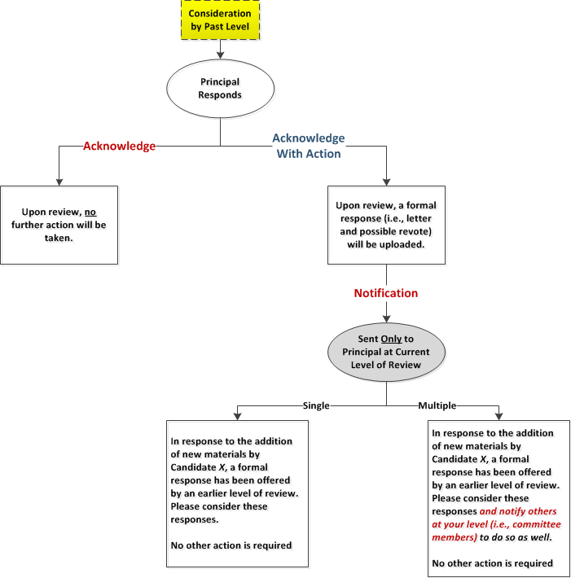
Supplemental Notifications & Actions II

Slide 16
Departmental Level
Pending
Evaluative folders/letters and vote record are now visible

Slide 17
School & Dean Levels

Slide 18
Campus Level

Slide 19
e-Dossier Workflow Overview
edossier@indiana.edu

