Slide 1
Reflections on Leadership: Looking Back to Move Forward
Angela Barron McBride, PhD, RN, FAAN
Distinguished Professor-Dean Emerita
Indiana University School of Nursing

Slide 2
Overview of Presentation
Looking back: The dreams of childhood vs. current realities
A word about my background
Becoming a leader
Lessons learned along the way
Moving forward

Slide 3
The Dreams of Childhood
Randy Pausch began his “last lecture” discussing his progress in achieving his childhood dreams
I didn’t have that many childhood dreams because a girl growing up in the 1940s and 1950s was supposed to stay open until marriage when you would find (and define) yourself in relationship to the man you would marry and the children you would have
A responsive posture, rather than a leadership stance

Slide 4
My Own Leadership Journey
1962
2011

Slide 5
My Background
Traditional background: policeman father and seamstress mother
Believed in education as key to success
Hints of leadership, but didn’t see self as leader
Began to take my possibilities seriously at Yale: “You must be a leader or you wouldn’t be here, so what will you do with your talents?”

Slide 6
Conflicted About Leadership
The issue for my generation wasn’t “Do you have a career?” but “Do you work outside the home after you have children?”
Educated to be a caregiver, so didn’t associate my skill set—facilitating, supporting, responding, educating, organizing—with leadership
The second wave of the women’s movement (Friedan, 1963) urged entry into domains of men, but inadvertently devalued traditional domains of women: “You’re smart; you should be a doctor not a nurse”
“Imposter phenomenon” (Clance & Imes, 1978)

Slide 7
Some Turning Points
A husband who always asked, “What do you want to do next?”
Writing The Growth and Development of Mothers (1973)
Becoming a National Kellogg Fellow (1981-84)

Slide 8
Becoming A Leader
Clinical responsibilities: charge nurse, coordinator of clinical training
Academic ladder: department chair, associate dean for research, university dean
Nursing organizations: president of Sigma Theta Tau International and American Academy of Nursing
Interdisciplinary boards: National Advisory Mental Health Council, NIH Office of Women’s Health, Indiana University Health

Slide 9
Leadership
…a process whereby the leader—either emergent or formally designated—inspires and catalyzes others to achieve shared values and institutional mission in an environment where the context and meanings (e.g., of health and aging) are evolving, thus the need to design new ways of doing things…
Not synonymous with administrative title
Ranges from individual performance and productive teamwork to inspiring higher performance in others and creating enduring excellence

Slide 10
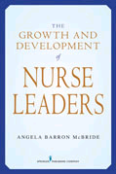
Nurse=Leader
Leadership as personal
Leadership as goal attainment
Leadership as transformational

Slide 11
Leadership as personal: self-aware, thoughtful, creative, resilient, courageous, savvy, responsive, self-regulating, emotional intelligence, persistent, tolerant
Leadership as goal attainment—problem analysis and definition, interpersonal and communication effectiveness, resource development (human and otherwise)
Leadership as transformational—grasp of complexity, strategic vision, striving for excellence, altering organizational realities

Slide 12
Lessons Learned
#1. Leadership=full career development
Preparation—formal education and socialization experiences
Independent contributions—working independently and interdependently to achieve professional expectations/outcomes
Development of home setting—building infrastructure, resources (human and financial), and image
Development of field—advancing profession to achieve public good
Gadfly period—free to be creatively provocative

Slide 13
#2. Mentors are important at each career stage (and you need to be one at each stage)
Preparation—model values; help set career goals
Independent contributions –help navigate inner workings of institution/profession; keep focus on benchmarks of success
Development of home setting—develop mentoring abilities; teach how to delegate
Development of field—discuss strategies and future scenarios; prepare for board work
Gadfly period—envision post-institutional-retirement opportunities

Slide 14
#3. Take responsibility for sustaining career optimism
Take care of yourself—exercise, diet, sleep, etc.
The 4 Cs of hardiness—committed to what you do; believing you can control some things; regarding change as offering opportunities; staying connected to community
Be careful about how you think about matters—overgeneralizing, ruminating, confronting irrational beliefs/expectations
Manage anger

Slide 15
#4. Know your strengths and limitations
Build on and extend strengths
Make friends with and/or hire those who like to do what you are not good at
Leadership isn’t doing everything yourself; it is making sure that important matters get addressed

Slide 16
#5. Leading the “full” life means that you are always doing triage
Prioritize
Think in terms of what is critical and important à la Covey
Say “no” softly and “yes” loudly
When saying no, be sure to pass on opportunities to others

Slide 17
#6. Feedback is important to success
You may never learn to like it
Projects always get better with feedback
Accept feedback graciously, but remember that you are the ultimate judge of how to use it
Give feedback in an ego-enhancing way—clear, specific, considerate, emphasizing learning not smartness
Feedback must include positive reinforcement

Slide 18
#7. Be values driven
Leaders need to stay on message for others to hear the message
The more you connect actions to values, the more you help others see the big picture
The more you connect actions to values, the more you do not get waylaid by distractions

Slide 19
#8. There is a difference between knowing what to do and getting things done
Getting things done requires you to know where people are coming from
Getting things done means you cannot just tell people what to do, but have to help them understand why next steps are necessary (sense-making is a major leadership role) and help them proceed forward

Slide 20
#9. Policy making and anything else that is important doesn’t belong to any one discipline or field, so be interdisciplinary
Leaders are boundary spanners
Participate in interdisciplinary forums; join interdisciplinary groups; publish in interdisciplinary journals
Need to read broadly and work with others who conceptualize the world differently to have a good sense of future trends

Slide 21
#10. Practice gratitude and appreciation
It helps you stay optimistic
Threads of connection (otherwise known as networking)—thank you notes, letters of recommendation, favors done and received—enable you to operate beyond your own limitations
Leadership isn’t just winning honors yourself, but helping others to do so

Slide 22
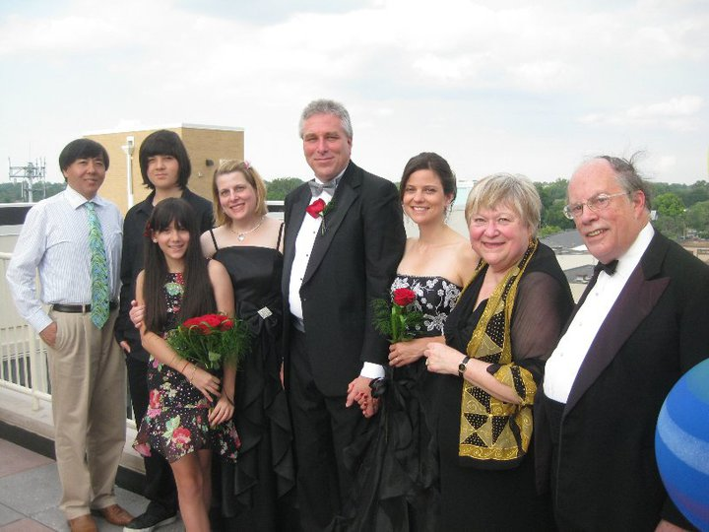
FAMILY

Slide 23
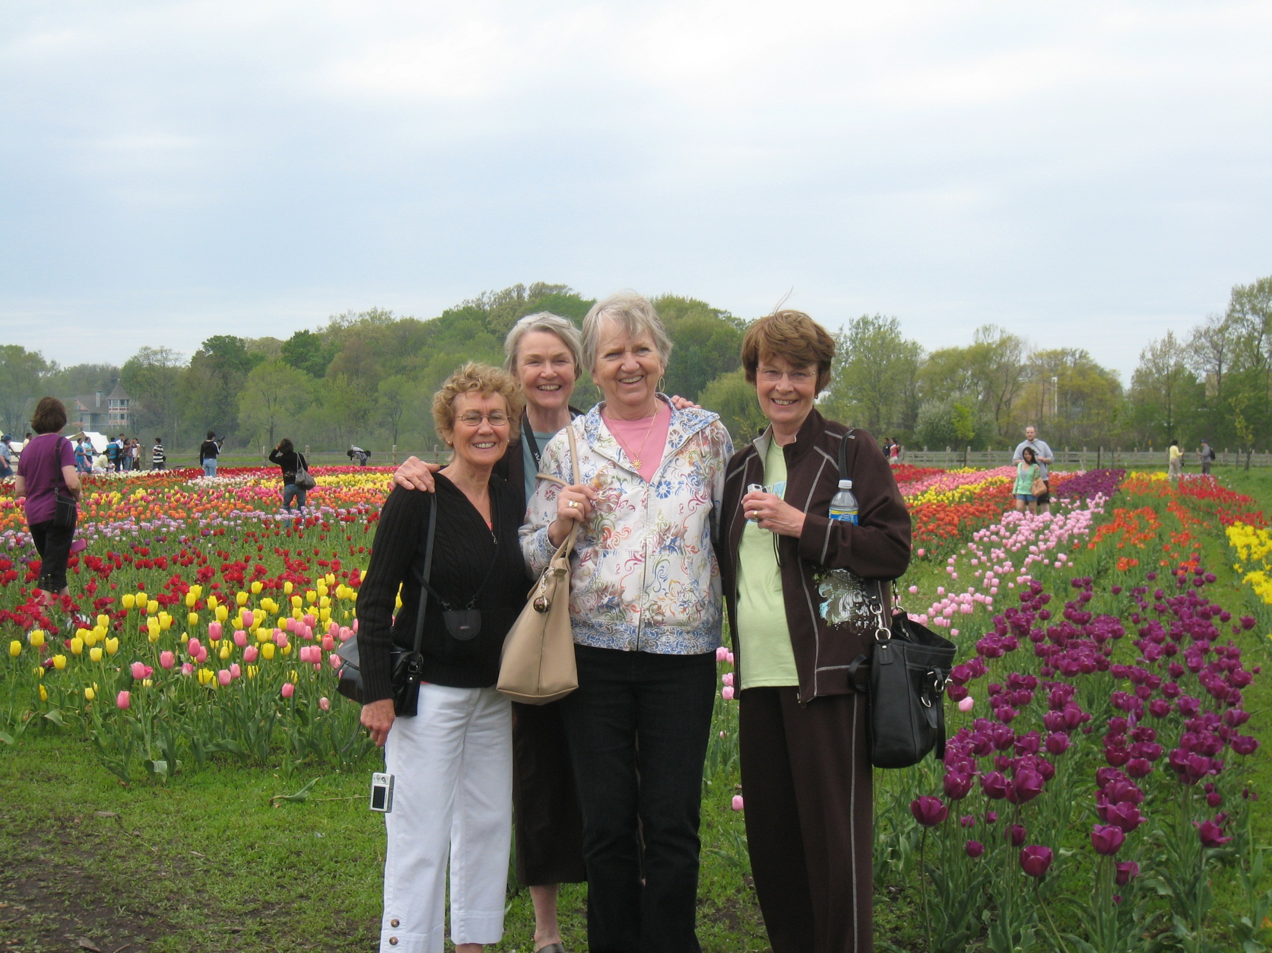
FRIENDS

Slide 24
Mentors
Rhetaugh Dumas
Doris Merritt

Slide 25
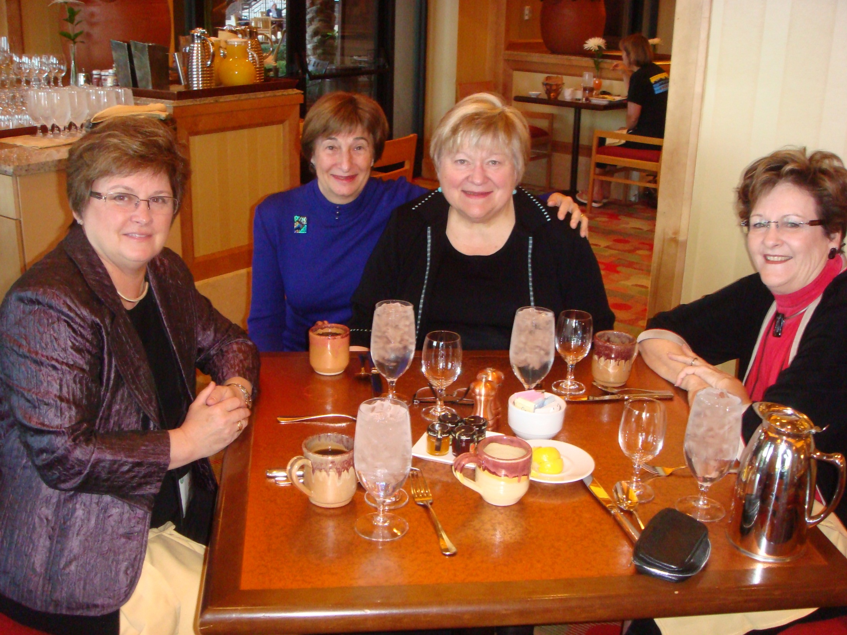
COLLEAGUES

Slide 26
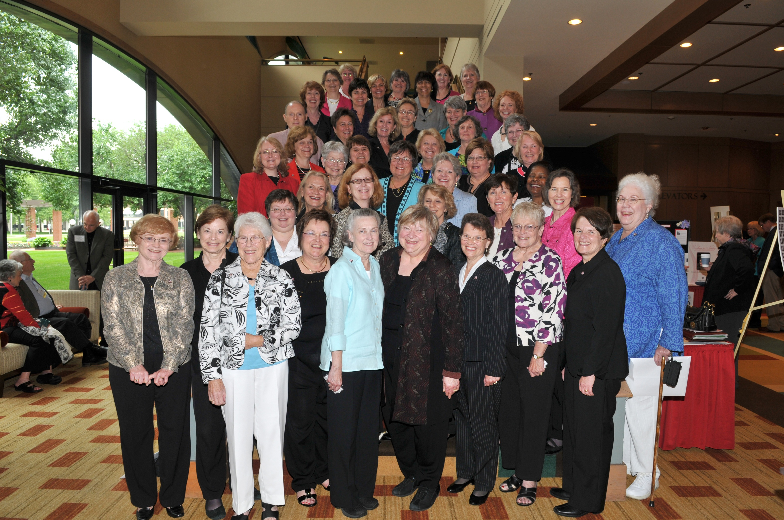

Slide 27
Moving Forward: Nurse Leadership and the IOM
IOM’s Keeping Patients Safe. Transforming the Work Environment of Nurses (2004) urged nurses to exert transformative leadership, take responsibility for the design of work and workspace to prevent and mitigate error, and serve as prime movers in developing organizational cultures of safety
IOM’s The Future of Nursing (2010) emphasized nurses practicing to the full extent of their education, more educated nurses, and nurses as full partners with physicians and other health professionals in redesigning and leading healthcare change (including serving on boards)

Slide 28
Leadership: A 21st-Century Expectation
A new equation nurse=leader
Leadership≠administration
Nurse leadership coming into its own
More understanding of the leadership journey
More programs aimed at nurturing leadership—Robert Wood Johnson Foundation’s Nurse Faculty Scholar Program, RWJF’s Executive Nurse Program, RWJF’s Health Policy Program, Hartford Foundation’s Building Academic Geriatric Nursing Program

Slide 29
Leadership
Career,
résumé lines,
but more than a long list.
What’s core is the sum total of
meaning.
Mentored,
then mentoring.
The challenge is to give
away self as you build substance
in place.
ABM

